Slide 1


AI/ML Hackathon 2026
DIABETES DETECTION USING RETINAL IMAGE ANALYSIS
2-Day AI/ML Hackathon for Engineering Students

Slide 2
Team Details.
Team Name
Neural Ninjas
Team Lead
Pooja Wandimali
Pooja Dematti
Simran Nadaf
Mohammad Tohid Jamadar
Team Members

Slide 3
Problem.
PROBLEM STATEMENT
To classify the stages of Diabetic Retinopathy (No DR, Mild, Moderate, Severe, Proliferative) using retinal images.

Slide 4
Proofs for Problem Statement.
Diabetic Retinopathy is one of the leading causes of blindness among working-age adults worldwide, and many cases go undetected due to lack of early screening.
https://www.who.int/news-room/fact-sheets/detail/blindness-and-visual-impairment
India has over 77 million diabetic patients, and a large percentage are at risk of developing retinal complications due to delayed diagnosis.
https://www.diabetesatlas.org
There is a shortage of ophthalmologists in rural areas, making timely diagnosis of retinal diseases difficult and increasing the risk of vision loss.
https://www.ncbi.nlm.nih.gov

Slide 5
AI-based system
AI-based system
AI-based system
Solve.
Our Solution
To design/develop a AI-based system for early detection of diabetes using retinal images that solves delayed diagnosis and risk of vision loss.

Slide 6
Tech Stack .
CNN Model
Because it can Extract features from retinal images. Detect patterns related to diabetic retinopathy.
ML /AI Engine
Backend and API
Flask (Python Backend)
Because it can Handle user requests and image uploads. Integrate ML model for prediction.

Slide 7
Tech Stack .
Our Frontend is HTML, CSS, JavaScript
Because it can Allow image upload easily. Display prediction results clearly.
Frontend and Dashboard
Infrastructure
This is our infrastructure: Local System
Because it can Store and process image data. Support real-time prediction.

Slide 8
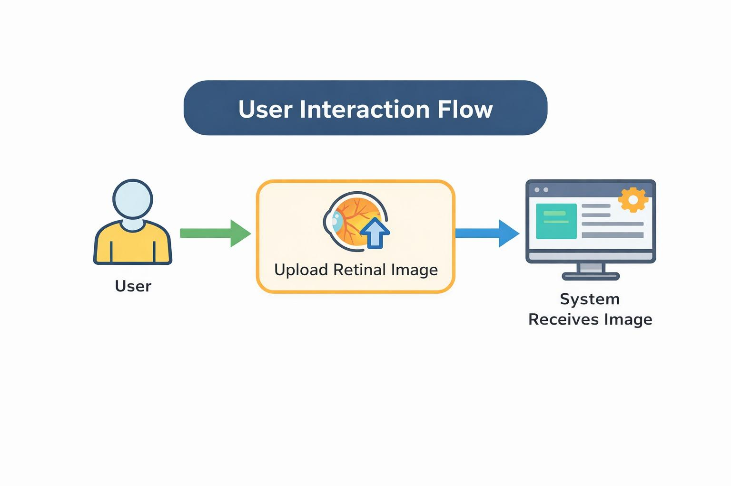
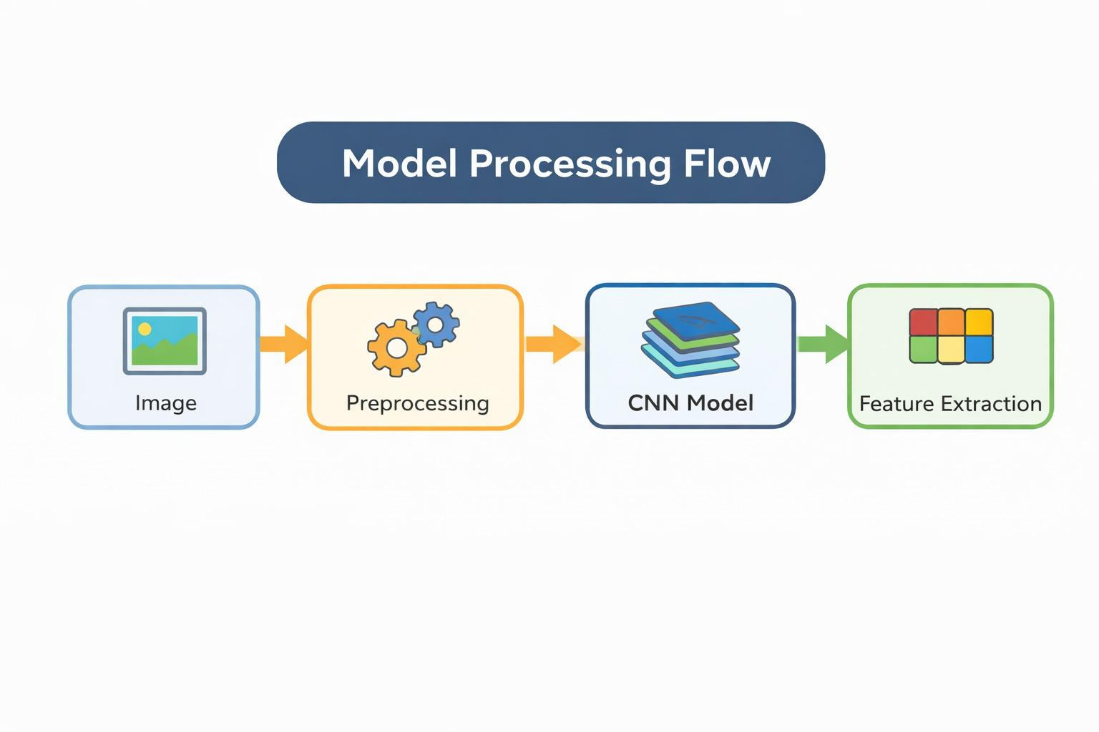
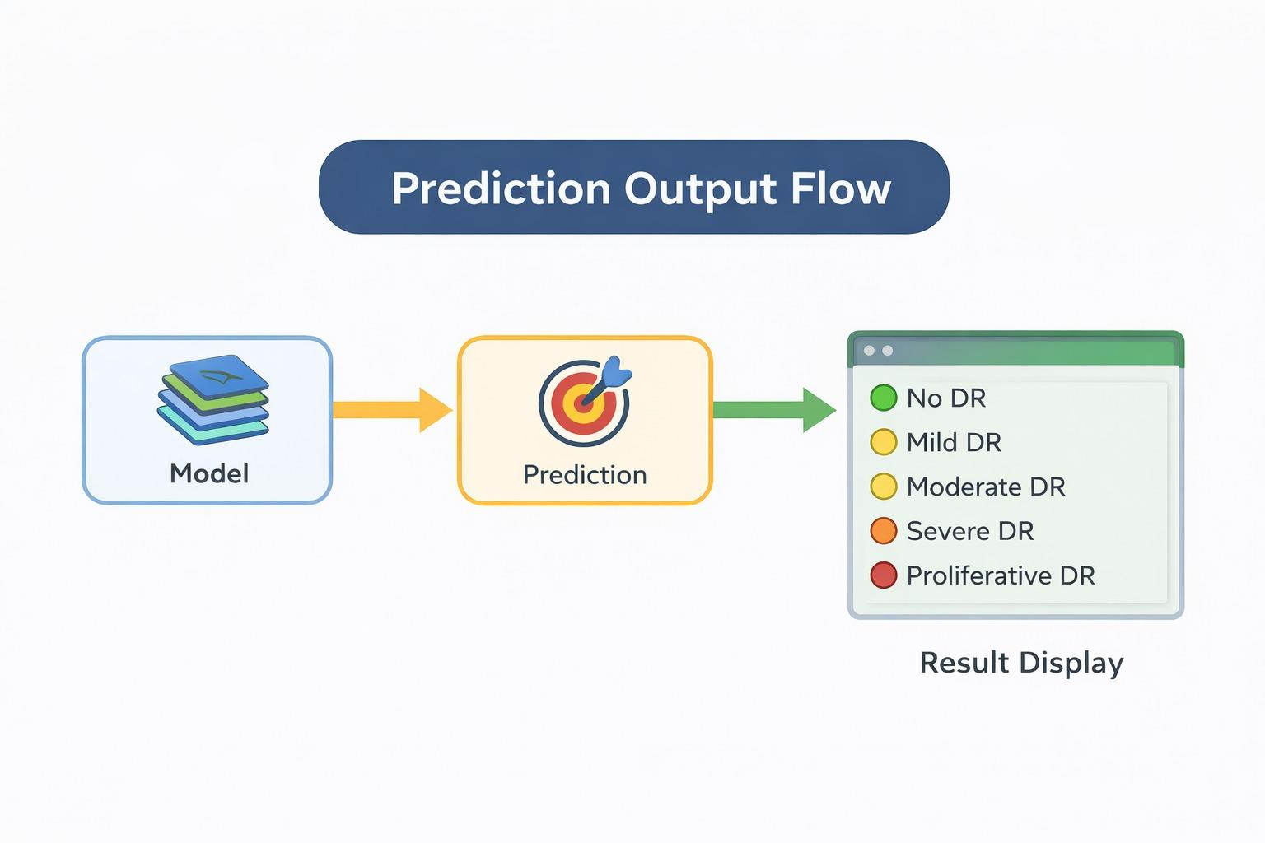
Solution Flow .
Patient
Perspective 1
System
Perspective 2
Doctor
Perspective 3

Slide 9
Expected Outcome .
Accuracy
~90%
Prediction Time
<10 Seconds
Detection
Stage wise classification of retinopathy

Slide 10
Actual Outcome .
Accuracy
85%
Prediction Time
7-8 Seconds
Detection
Successfully classifies diabetic retinopathy stages

Slide 11
Impact .
Reduces diagnosis time
8 Hours
to
10 Minutes
Improves Detection
Late
to
Early Stage Detection
Accessibility
Manual Diagnosis
to
AI-based System

